Slide 1



Zemgale Regional Energy Agency
Latvia

Slide 2










ZREA members
Jelgava City Council
SIA “Fortum Jelgava”
Jekabpils City Council
Auce County Municipality
Bauska County Municipality
Society “Zemgale Regional NGO
support centre”
Ozolnieki County Municipality
Jelgava Housing Company SIA “Jelgavas nekustamā
īpašumu pārvalde”
Krustpils County Municipality

Slide 3
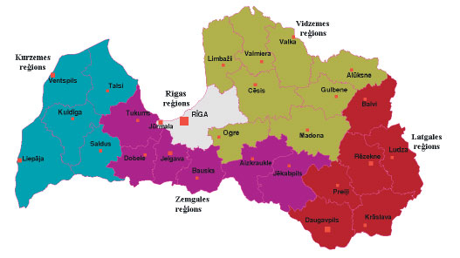
Location of Zemgale Region – in the central part of Latvia

Slide 4
Mission
To be a provider of modern and highly
valuable solutions in
energy management
To support Energy Management,
Energy Efficiency and increased use of Renewable Energy Sources
in Communities of Zemgale Region, Latvia

Slide 5
Energy planning
Sustainable Energy Action Plans elaborated in 2009 – 2011:
For Jelgava City
For Jekabpils City
For Zemgale Region

Slide 6
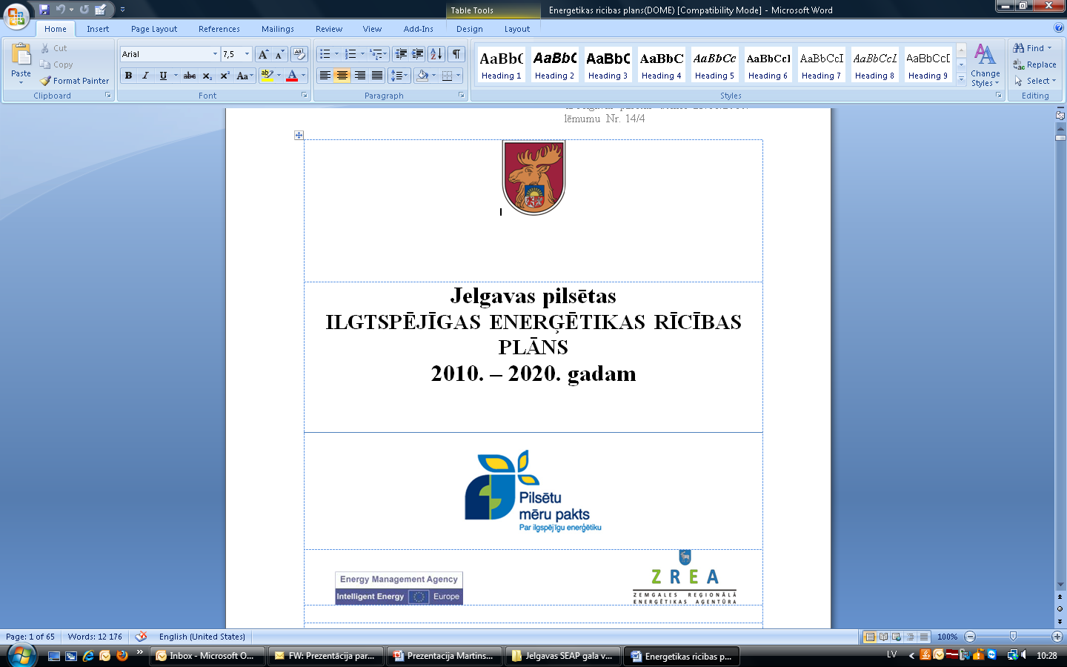

Slide 7
Main Areas of Work:
Promotion and facilitating of energy efficient renovations of multi residential buildings as 66% of Latvia population lives in such buildings being a biggest energy consumer;
Promotion of use of Renewable Energy Resources (seminars, energy days;
Promotion of sustainable transport - electric vehicles, electric hybrid vehicles and cycling in Zemgale region;
Provision of consultations on EE and RES, green transport.

Slide 8
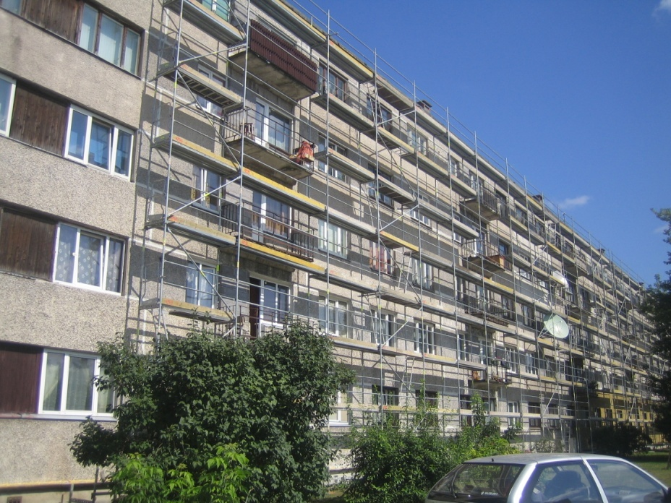
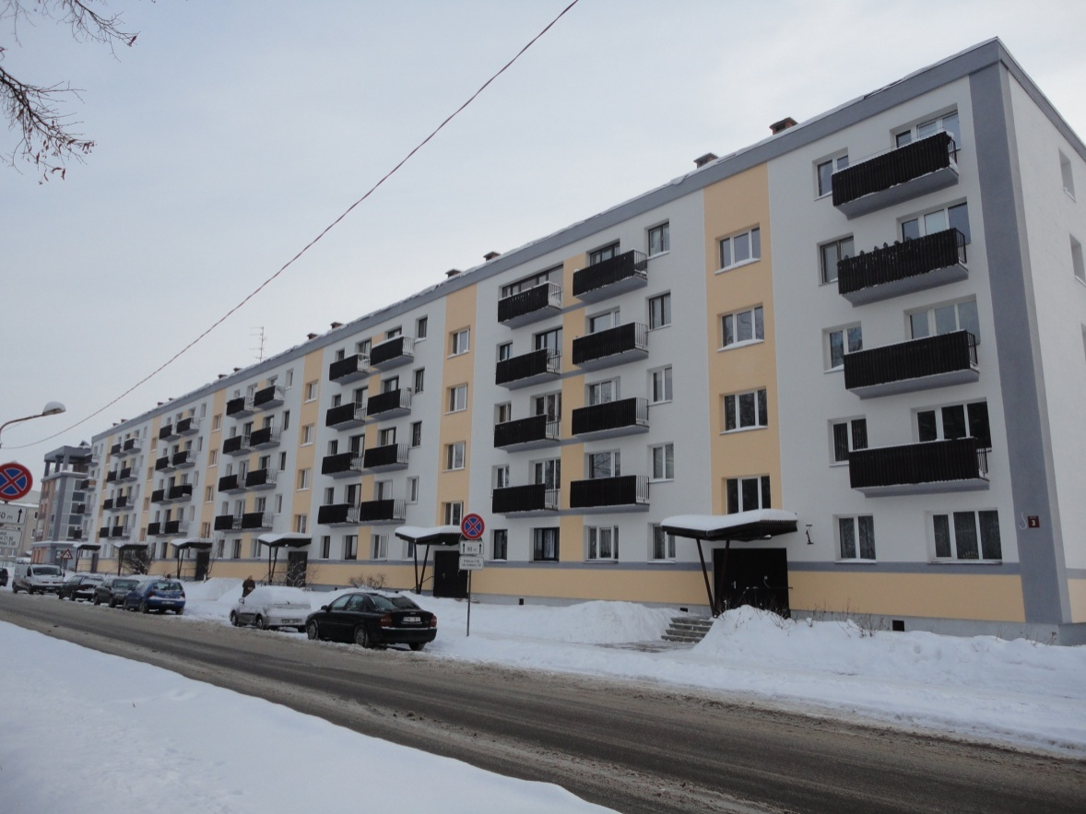
Result: 35 Project applications for EU funding for energy efficient refurbishment of multi residential buildings prepared with ZREA assistance
Before
After

Slide 9
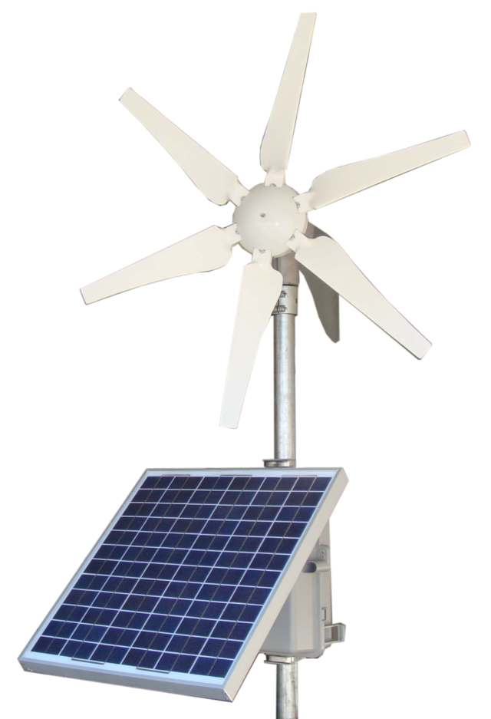
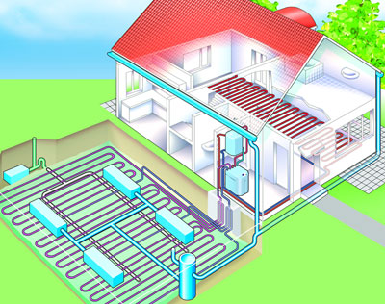
Result: 50 Project applications for National funding (Climate Change Finance Instrument) for use of renewable energy resources in the heating of the households prepared with ZREA assistance

Slide 10
Exchange of experience
Learning from tutor energy agencies
Exchange of experience, cooperation with other EU energy agencies
Dissemination of best practices to other EU energy agencies

Slide 11
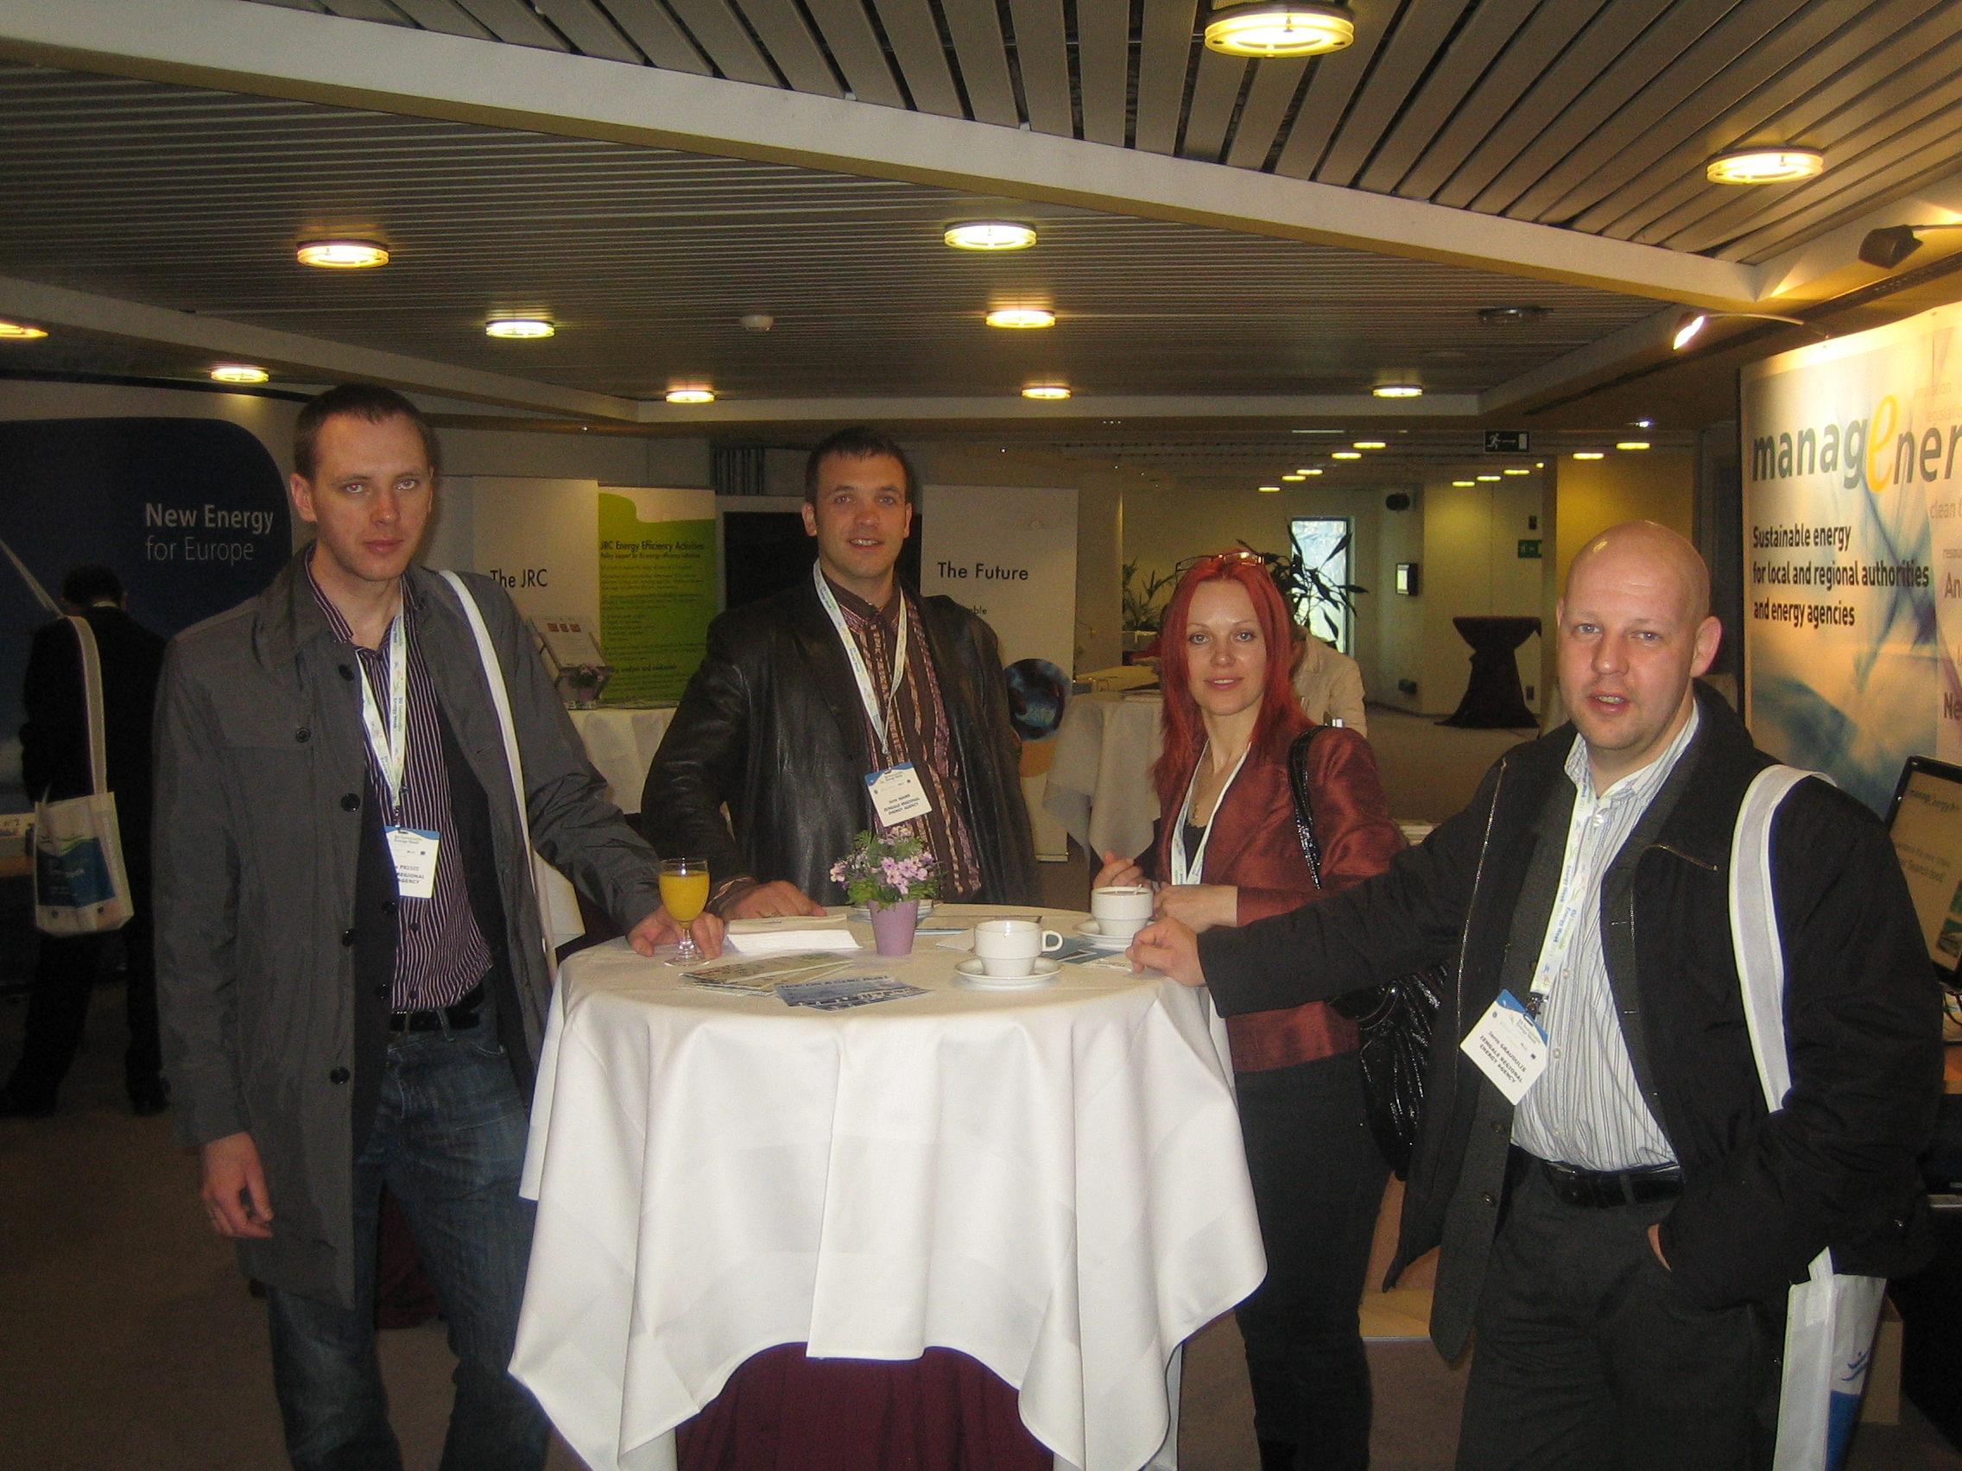
ZREA team

Slide 12
Contacts
Zemgale Regional Energy Agency
26 Pulkveza Brieza street
Jelgava, LV – 3007
Latvia
Mob. phone:+371 20023868
Phone: +371 63080205
Fax: +371 63080206
zrea@zrea.lv, www.zrea.lv
Zemgale Regional Energy Agency
Jekabpils office
4a Nameja Street
Jekabpils, LV – 5201
Latvia
Mob.phone: +371 28830207
ainars@zrea.lv

Slide 13
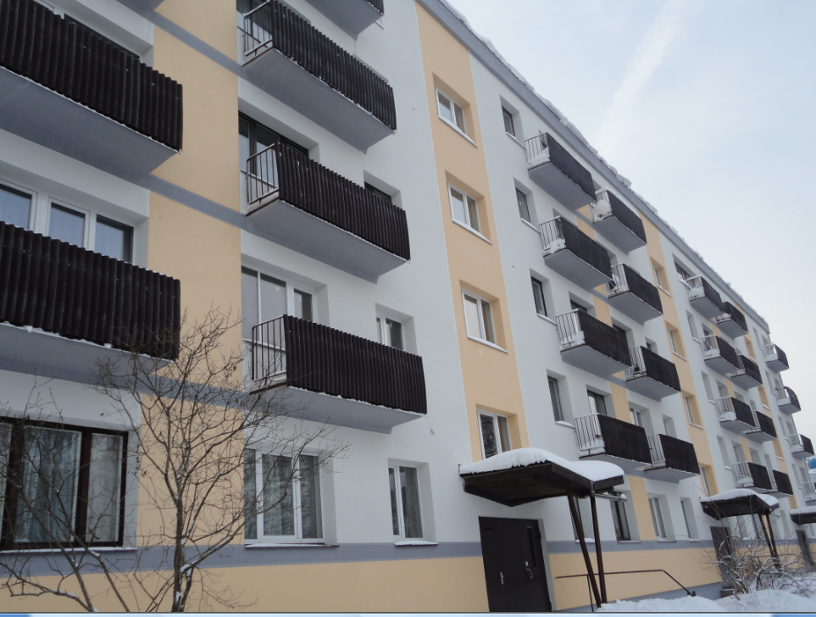
Thank you for your attention!

